Slide 1
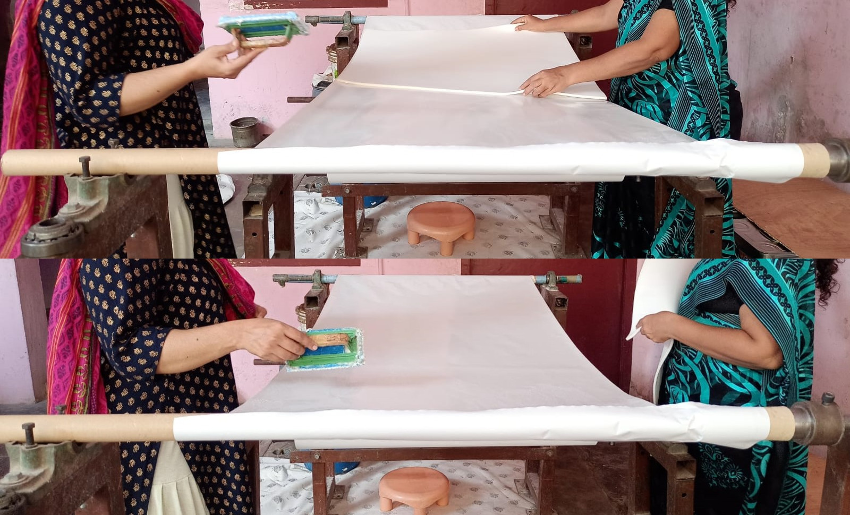
IMPROVING THE ACCOUNTS RECEIVABLES AGING OF A FOAM DEALER FOR THE FOOTWEAR INDUSTRY
Name-Sathya Prakash
Roll number:- 21f10006001

Slide 2
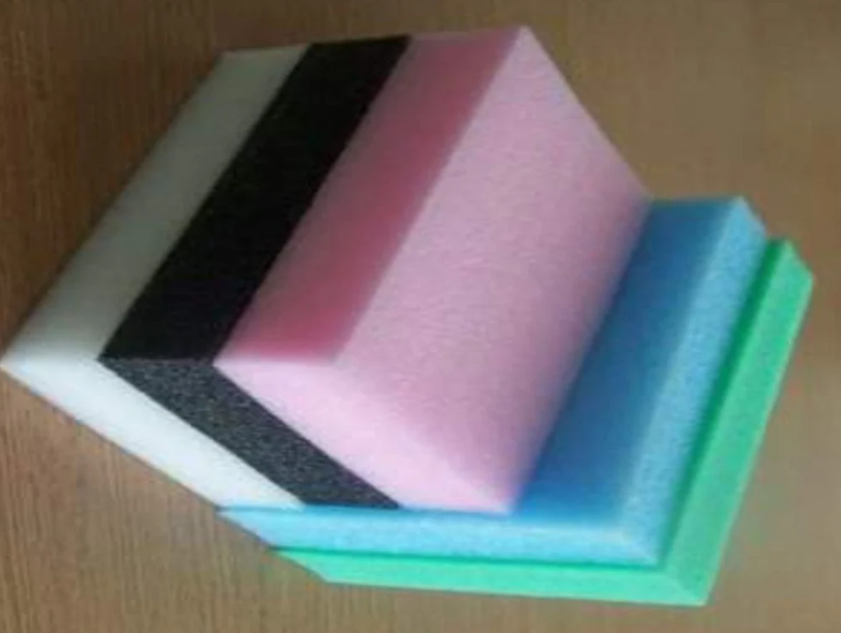

Details of the Organization
Sara Internationals is a foam dealer (a B2B type of business) for the footwear industry located in Pallavaram, Chennai, owned by Mr. Syed Nazeem and operates with five employees with an annual turnover of around Rs. 80 lakhs.
It is known to provide top service in the following categories: Foam Sheets, Polyurethane Foam Sheets, High-Density Polyurethane Foam Sheets, Phenolic Foam Sheets, Interlining, and Outer lining for the footwear industries.
Basically they process the foam to alter the density and thickness by various compression techniques, according to the requirements of different customers across the footwear industry.

Slide 3
Problem Statement
Account receivables aging:
The customer and the firm have terms on which the invoices had to be settled. But customers keep failing to pay the due within the terms, which must be collected with frequent follow-ups.
This in turn makes operations difficult for Mr. Nazeem as the accounts should be in float for the next round of operations, like buying raw materials, to keep the concern going and be cash flow positive.
Competition:
This business involves serious competition, with approximately 12 competitors, where a customer could easily replace one supplier with another.
Competitors can directly affect a business and influence many business decisions, like pricing. It prevails to be a big task for this business to handle its competitors.

Slide 4
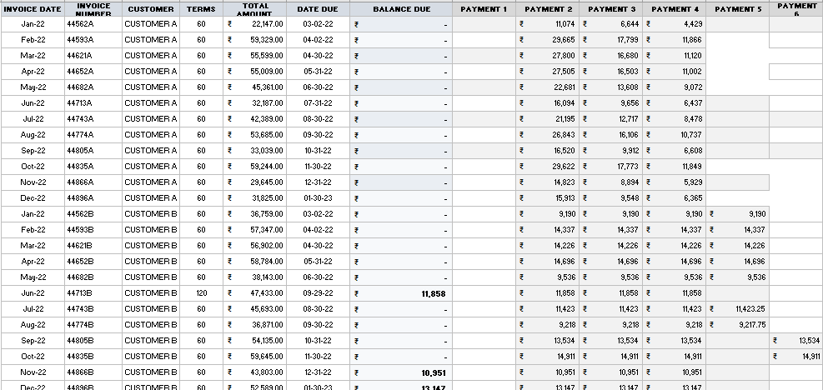
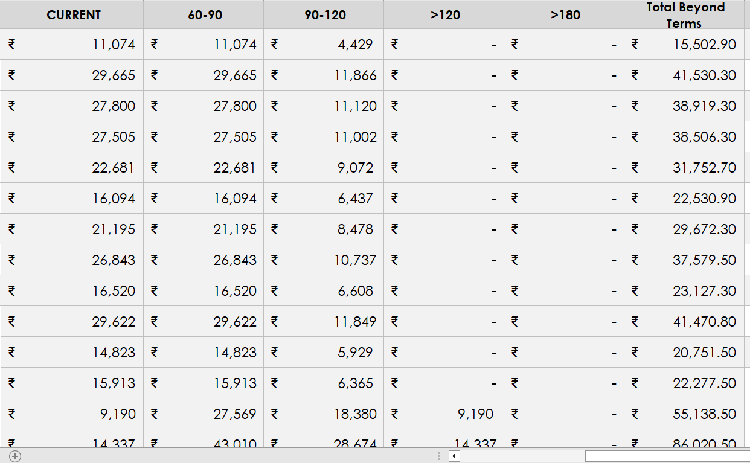
Analysis Methodology
It is an effective approach to take each customer's total revenue into account so that the overall impact of the customer on the organization is correctly understood.
A summarized A/R aging report that will have one total for each customer broken up by the age of the invoice, which will typically be grouped by: 60 to 90 days, 91 to 120 days, 121 to 150 days, 151 to 180 days, and over 180 days.
Along with aging buckets, common metrics like the average days’ sales outstanding (DSO), percentage of overdue AR, and collection effectiveness index (CEI) have been calculated based on the aging report data

Slide 5
Key Insights
We can observe a dip in revenue during the months of December and January, a decline in demand for the shoes, which in turn affects the revenue of the organization.
We can say that the customers, B, F, G, H, and K, with higher contributions to the organization’s revenue are regular customers who do business throughout the year.

Slide 6
Our dataset has six payment windows each differing from 30-60 days. Different proportions of the total amount are paid at different payment windows. Customers with a higher number of installments must be noted.
Customers F, B, and D, are found to be frequent defaulters, as they contribute to high total amounts of outstanding, their payment patterns and the terms agreed upon should be negotiated and revised.
It is found that most of these slow-paying customers are associated with the organization for the long term, so certain adjustments are being made to maintain the relationship.

Slide 7
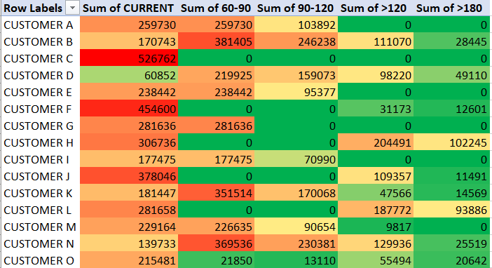
Customers B, H, K, M, L, J, and N have records of paying bills beyond 180 days (on an average of about 40,000 to 1,00,000 INR). And we can segment them into slow-paying customers as they also have a very less proportion of the amount in current payments.
We can observe that customers B, D, H, L, N, and K have poor payment patterns by paying 50-70% of their balance beyond the term, which affects the cash flow of the firm. From the heatmap, we can pinpoint the concentration of payments of different customers, which helps us to tailor customized measures to collect the A/R in accordance with each customer.

Slide 8
Collection Efficiency Index = (Actual Collections / Total Outstanding AR Balances) * 100
CEI of SI = (25,22,463/52,47,766) * 100 = 48.06%
(Total Outstanding = Balance Overdue + Total Beyond Terms)
CEI helps to assess the effectiveness of the organization’s collections efforts. A higher percentage indicates a more efficient collection process.
Customers B, D, K, N, and O have high deviations of about 30,000-50,000 INR, in their payments. Identifying these warning signs allows for proactive measures to address the underlying issues and mitigate the risk of payment delays.

Slide 9
Recommendations
1. Segmentation of Customers: Segment customers based on their payment behavior and financial stability. Prioritize high-value customers or those with significant overdue balances to tailor collection strategies.
2. Assess Credit and Collection Policies: Review credit and collection policies to ensure they align with the organization's goals. Evaluate the credit approval process, terms and conditions.
3. Effective Communication and Proactive Follow-up: Establish effective communication channels with customers to address overdue payments. Timely communication can help resolve payment issues and prevent further aging.
4. Implement AR Automation: Consider implementing AR automation solutions, such as electronic invoicing, online payment portals, or automated reminders.

Slide 10
5. Monitor and Track Progress: Continuously monitor AR aging metrics and track the progress of improvement initiatives. Identify any emerging issues and take proactive measures to address them promptly
6. Review and Adjust Strategies: Regularly review the effectiveness of implemented strategies and make necessary adjustments.
On looking at the potential solutions to handle our secondary problem, the competition, we can recommend the following:
1. Understanding the competitors - As already mentioned before, a way of attracting new customers is by planning on giving better by offering, some value-added service or offering differentiated products from counterparts.
2. Proactive measures to handle fellow competitors - Competitive intelligence assessment may identify some action that could be taken accordingly. By giving the ad-hoc customers the leverage of credit Sara International should look to gain their loyalties. Eventually, it may give the firm a competitive edge over other competitors.

